Slide 1


MINI PROJECT
SDGs - Zero Hunger(2)
"Together, we can nourish bodies, clothe lives, and empower minds."

Slide 2

SEVA SANGH
SEVA SANGH is a comprehensive web application designed to address and alleviate poverty by creating a direct and efficient connection between individuals in need and compassionate donors or volunteers.
The platform aims to foster community support, empower users with knowledge, and track the positive impact of connections made through the app.

Slide 3
Our Team and Mentorship
Team Members:-
Kulkamal Singh
Divye Gupta
Dolly Sharma
Nitish Jha
Mentor :-
Prof. Neelam Rawat
SEVA SANGH
SEVA SANGH is a comprehensive web application designed to address and alleviate poverty by creating a direct and efficient connection between individuals in need and compassionate donors or volunteers.
The platform aims to foster community support, empower users with knowledge, and track the positive impact of connections made through the app.

Slide 4
Project Overview
SEVA SANGH
Our Team and Mentorship
Seva Sangh is a comprehensive web application designed to address and alleviate poverty by creating a direct and efficient connection between needy individuals and compassionate donors or volunteers. The platform aims to foster community support, empower users with knowledge, and track the positive impact of connections made through the app.
Team Members:-
Kulkamal Singh (2300290140092)
Harsh (2300290140066)
Harsh Yadav (2300290140071)
Khushi (2300290140088)
Mentor :-
Ms. Neelam Rawat
(Associate Professor)
SEVA SANGH is a comprehensive web application designed to address and alleviate poverty by creating a direct and efficient connection between individuals in need and compassionate donors or volunteers.
The platform aims to foster community support, empower users with knowledge, and track the positive impact of connections made through the app.

Slide 5

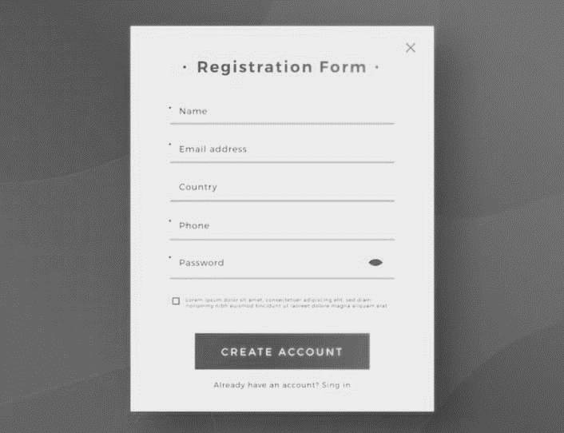

Project Overview
Seva Sangh is a comprehensive web application designed to address and alleviate poverty by creating a direct and efficient connection between needy individuals and compassionate donors or volunteers. The platform aims to foster community support, empower users with knowledge, and track the positive impact of connections made through the app.
Our Team and Mentorship
Key Features
User Profiles:-
Allow users to create profiles with information about their needs, such as essential items, financial assistance, or specific skills they are looking for.
Donor/Volunteer Registration:-
Enable donors and volunteers to register on the platform, providing details about their willingness to contribute, whether through financial donations, goods, or services.
Team Members:-
Kulkamal Singh
Divye Gupta
Dolly Sharma
Nitish Jha
Mentor :-
Prof. Neelam Rawat
3. Feedback and Ratings:-
Allow users to provide feedback and ratings based on their interactions, building a trustworthy and supportive community.

Slide 6

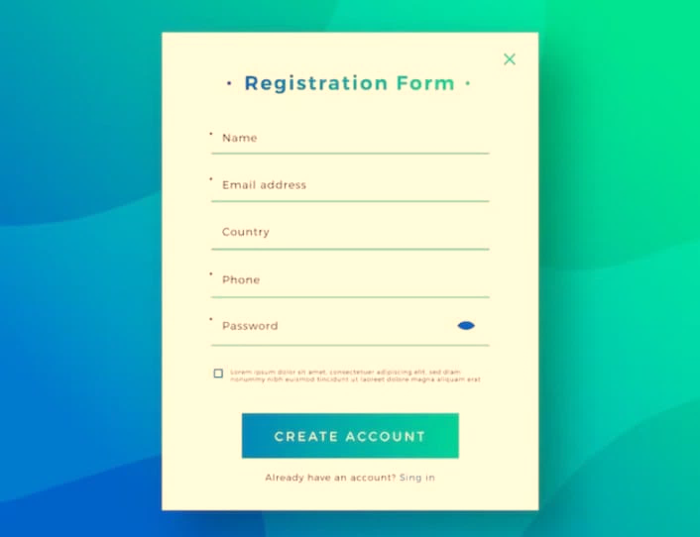
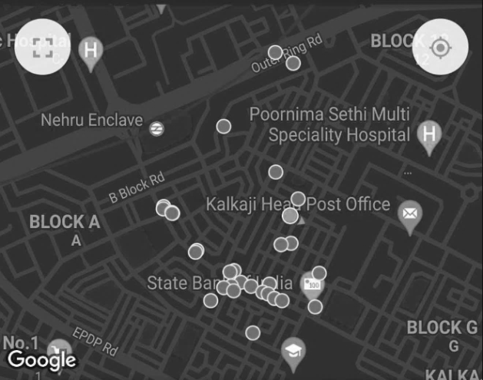
User Profiles:-
Allow users to create profiles with information about their needs, such as essential items, financial assistance, or specific skills they are looking for.
Key Features
Project Overview
Seva Sangh is a comprehensive web application designed to address and alleviate poverty by creating a direct and efficient connection between needy individuals and compassionate donors or volunteers. The platform aims to foster community support, empower users with knowledge, and track the positive impact of connections made through the app.
Our Team and Mentorship
Donor/Volunteer Registration:-
Enable donors and volunteers to register on the platform, providing details about their willingness to contribute, whether through financial donations, goods, or services.
3. Feedback and Ratings:-
Allow users to provide feedback and ratings based on their interactions, building a trustworthy and supportive community.
4. Matching Algorithm:-
Implement a matching algorithm that connects individuals in need with suitable donors or volunteers based on location, preferences, and specific requirements.
Team Members:-
Kulkamal Singh
Divye Gupta
Dolly Sharma
Nitish Jha
Mentor :-
Neelam Mam

Slide 7

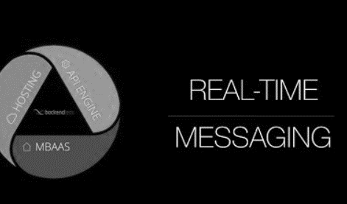
User Profiles:-
Allow users to create profiles with information about their needs, such as essential items, financial assistance, or specific skills they are looking for.
Donor/Volunteer Registration:-
Enable donors and volunteers to register on the platform, providing details about their willingness to contribute, whether through financial donations, goods, or services.
Seva Sangh is a comprehensive web application designed to address and alleviate poverty by creating a direct and efficient connection between needy individuals and compassionate donors or volunteers. The platform aims to foster community support, empower users with knowledge, and track the positive impact of connections made through the app.
Key Features
Project Overview
Our Team and Mentorship
3. Feedback and Ratings:-
Allow users to provide feedback and ratings based on their interactions, building a trustworthy and supportive community.
4. Matching Algorithm:-
Implement a matching algorithm that connects individuals in need with suitable donors or volunteers based on location, preferences, and specific requirements.
5. Real-time Messaging:-
Integrate a messaging system to facilitate communication between the parties involved, ensuring a transparent and secure channel for discussions and coordination.
Team Members:-
Kulkamal Singh
Divye Gupta
Dolly Sharma
Nitish Jha
Mentor :-
Neelam Mam

Slide 8

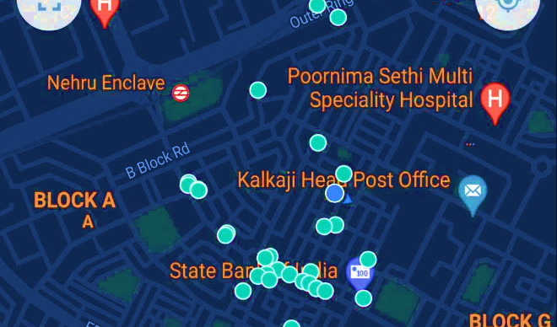

User Profiles:-
Allow users to create profiles with information about their needs, such as essential items, financial assistance, or specific skills they are looking for.
Donor/Volunteer Registration:-
Enable donors and volunteers to register on the platform, providing details about their willingness to contribute, whether through financial donations, goods, or services.
3. Feedback and Ratings:-
Allow users to provide feedback and ratings based on their interactions, building a trustworthy and supportive community.
Key Features
Project Overview
4. Matching Algorithm:-
Implement a matching algorithm that connects individuals in need with suitable donors or volunteers based on location, preferences, and specific requirements.
Our Team and Mentorship
Seva Sangh is a comprehensive web application designed to address and alleviate poverty by creating a direct and efficient connection between needy individuals and compassionate donors or volunteers. The platform aims to foster community support, empower users with knowledge, and track the positive impact of connections made through the app.
5. Real-time Messaging:-
Integrate a messaging system to facilitate communication between the parties involved, ensuring a transparent and secure channel for discussions and coordination.
Team Members:-
Kulkamal Singh
Divye Gupta
Dolly Sharma
Nitish Jha
Mentor :-
Neelam Mam
6. Resource Listings:-
Create a section where donors can list available resources, such as food, clothing, or educational materials, making it easy for those in need to browse and request assistance.

Slide 9
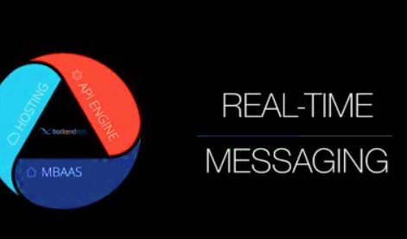

4. Matching Algorithm:-
Implement a matching algorithm that connects individuals in need with suitable donors or volunteers based on location, preferences, and specific requirements.
User Profiles:-
Allow users to create profiles with information about their needs, such as essential items, financial assistance, or specific skills they are looking for.
Donor/Volunteer Registration:-
Enable donors and volunteers to register on the platform, providing details about their willingness to contribute, whether through financial donations, goods, or services.
3. Feedback and Ratings:-
Allow users to provide feedback and ratings based on their interactions, building a trustworthy and supportive community.
Key Features
Project Overview
Seva Sangh is a comprehensive web application designed to address and alleviate poverty by creating a direct and efficient connection between needy individuals and compassionate donors or volunteers. The platform aims to foster community support, empower users with knowledge, and track the positive impact of connections made through the app.
Our Team and Mentorship
5. Real-time Messaging:-
Integrate a messaging system to facilitate communication between the parties involved, ensuring a transparent and secure channel for discussions and coordination.
6. Resource Listings:-
Create a section where donors can list available resources, such as food, clothing, or educational materials, making it easy for those in need to browse and request assistance.
Team Members:-
Kulkamal Singh
Divye Gupta
Dolly Sharma
Nitish Jha
Mentor :-
Neelam Mam
7. Verification System:-
Implement a verification process for both those seeking assistance and those offering help to ensure the legitimacy of users and the safety of transactions.

Slide 10



User Profiles:-
Allow users to create profiles with information about their needs, such as essential items, financial assistance, or specific skills they are looking for.
4. Matching Algorithm:-
Implement a matching algorithm that connects individuals in need with suitable donors or volunteers based on location, preferences, and specific requirements.
5. Real-time Messaging:-
Integrate a messaging system to facilitate communication between the parties involved, ensuring a transparent and secure channel for discussions and coordination.
Donor/Volunteer Registration:-
Enable donors and volunteers to register on the platform, providing details about their willingness to contribute, whether through financial donations, goods, or services.
3. Feedback and Ratings:-
Allow users to provide feedback and ratings based on their interactions, building a trustworthy and supportive community.
Key Features
Project Overview
Seva Sangh is a comprehensive web application designed to address and alleviate poverty by creating a direct and efficient connection between needy individuals and compassionate donors or volunteers. The platform aims to foster community support, empower users with knowledge, and track the positive impact of connections made through the app.
6. Resource Listings:-
Create a section where donors can list available resources, such as food, clothing, or educational materials, making it easy for those in need to browse and request assistance.
Our Team and Mentorship
7. Verification System:-
Implement a verification process for both those seeking assistance and those offering help to ensure the legitimacy of users and the safety of transactions.
Team Members:-
Kulkamal Singh
Divye Gupta
Dolly Sharma
Nitish Jha
Mentor :-
Neelam Mam
8.Community Forum:-
Include a community forum where users can share success stories, offer advice, and discuss strategies for overcoming poverty.

Slide 11



User Profiles:-
Allow users to create profiles with information about their needs, such as essential items, financial assistance, or specific skills they are looking for.
6. Resource Listings:-
Create a section where donors can list available resources, such as food, clothing, or educational materials, making it easy for those in need to browse and request assistance.
4. Matching Algorithm:-
Implement a matching algorithm that connects individuals in need with suitable donors or volunteers based on location, preferences, and specific requirements.
Donor/Volunteer Registration:-
Enable donors and volunteers to register on the platform, providing details about their willingness to contribute, whether through financial donations, goods, or services.
3. Feedback and Ratings:-
Allow users to provide feedback and ratings based on their interactions, building a trustworthy and supportive community.
5. Real-time Messaging:-
Integrate a messaging system to facilitate communication between the parties involved, ensuring a transparent and secure channel for discussions and coordination.
Key Features
Project Overview
Seva Sangh is a comprehensive web application designed to address and alleviate poverty by creating a direct and efficient connection between needy individuals and compassionate donors or volunteers. The platform aims to foster community support, empower users with knowledge, and track the positive impact of connections made through the app.
7. Verification System:-
Implement a verification process for both those seeking assistance and those offering help to ensure the legitimacy of users and the safety of transactions.
Our Team and Mentorship
8.Community Forum:-
Include a community forum where users can share success stories, offer advice, and discuss strategies for overcoming poverty.
Team Members:-
Kulkamal Singh
Divye Gupta
Dolly Sharma
Nitish Jha
Mentor :-
Neelam Mam
9. Localized Information:-
Provide information on local support services, government programs, and community events related to poverty alleviation.

Slide 12


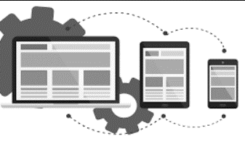
User Profiles:-
Allow users to create profiles with information about their needs, such as essential items, financial assistance, or specific skills they are looking for.
7. Verification System:-
Implement a verification process for both those seeking assistance and those offering help to ensure the legitimacy of users and the safety of transactions.
6. Resource Listings:-
Create a section where donors can list available resources, such as food, clothing, or educational materials, making it easy for those in need to browse and request assistance.
4. Matching Algorithm:-
Implement a matching algorithm that connects individuals in need with suitable donors or volunteers based on location, preferences, and specific requirements.
Donor/Volunteer Registration:-
Enable donors and volunteers to register on the platform, providing details about their willingness to contribute, whether through financial donations, goods, or services.
3. Feedback and Ratings:-
Allow users to provide feedback and ratings based on their interactions, building a trustworthy and supportive community.
5. Real-time Messaging:-
Integrate a messaging system to facilitate communication between the parties involved, ensuring a transparent and secure channel for discussions and coordination.
Seva Sangh is a comprehensive web application designed to address and alleviate poverty by creating a direct and efficient connection between needy individuals and compassionate donors or volunteers. The platform aims to foster community support, empower users with knowledge, and track the positive impact of connections made through the app.
Key Features
Project Overview
8.Community Forum:-
Include a community forum where users can share success stories, offer advice, and discuss strategies for overcoming poverty.
Our Team and Mentorship
9. Localized Information:-
Provide information on local support services, government programs, and community events related to poverty alleviation.
Mobile Responsiveness:-
Ensure that the web app is mobile-friendly, making it accessible to a broader range of users.
Team Members:-
Kulkamal Singh
Divye Gupta
Dolly Sharma
Nitish Jha
Mentor :-
Neelam Mam

Slide 13

User Profiles:-
Allow users to create profiles with information about their needs, such as essential items, financial assistance, or specific skills they are looking for.
7. Verification System:-
Implement a verification process for both those seeking assistance and those offering help to ensure the legitimacy of users and the safety of transactions.
8.Community Forum:-
Include a community forum where users can share success stories, offer advice, and discuss strategies for overcoming poverty.
6. Resource Listings:-
Create a section where donors can list available resources, such as food, clothing, or educational materials, making it easy for those in need to browse and request assistance.
4. Matching Algorithm:-
Implement a matching algorithm that connects individuals in need with suitable donors or volunteers based on location, preferences, and specific requirements.
Donor/Volunteer Registration:-
Enable donors and volunteers to register on the platform, providing details about their willingness to contribute, whether through financial donations, goods, or services.
3. Feedback and Ratings:-
Allow users to provide feedback and ratings based on their interactions, building a trustworthy and supportive community.
5. Real-time Messaging:-
Integrate a messaging system to facilitate communication between the parties involved, ensuring a transparent and secure channel for discussions and coordination.
Key Features
Project Overview
Seva Sangh is a comprehensive web application designed to address and alleviate poverty by creating a direct and efficient connection between needy individuals and compassionate donors or volunteers. The platform aims to foster community support, empower users with knowledge, and track the positive impact of connections made through the app.
Our Team and Mentorship
9. Localized Information:-
Provide information on local support services, government programs, and community events related to poverty alleviation.
Mobile Responsiveness:-
Ensure that the web app is mobile-friendly, making it accessible to a broader range of users.
Team Members:-
Kulkamal Singh
Divye Gupta
Dolly Sharma
Nitish Jha
Mentor :-
Neelam Mam

Slide 14

9. Localized Information:-
Provide information on local support services, government programs, and community events related to poverty alleviation.
User Profiles:-
Allow users to create profiles with information about their needs, such as essential items, financial assistance, or specific skills they are looking for.
7. Verification System:-
Implement a verification process for both those seeking assistance and those offering help to ensure the legitimacy of users and the safety of transactions.
8.Community Forum:-
Include a community forum where users can share success stories, offer advice, and discuss strategies for overcoming poverty.
6. Resource Listings:-
Create a section where donors can list available resources, such as food, clothing, or educational materials, making it easy for those in need to browse and request assistance.
4. Matching Algorithm:-
Implement a matching algorithm that connects individuals in need with suitable donors or volunteers based on location, preferences, and specific requirements.
Donor/Volunteer Registration:-
Enable donors and volunteers to register on the platform, providing details about their willingness to contribute, whether through financial donations, goods, or services.
3. Feedback and Ratings:-
Allow users to provide feedback and ratings based on their interactions, building a trustworthy and supportive community.
5. Real-time Messaging:-
Integrate a messaging system to facilitate communication between the parties involved, ensuring a transparent and secure channel for discussions and coordination.
Key Features
Project Overview
Seva Sangh is a comprehensive web application designed to address and alleviate poverty by creating a direct and efficient connection between needy individuals and compassionate donors or volunteers. The platform aims to foster community support, empower users with knowledge, and track the positive impact of connections made through the app.
Our Team and Mentorship
Mobile Responsiveness:-
Ensure that the web app is mobile-friendly, making it accessible to a broader range of users.
Team Members:-
Kulkamal Singh
Divye Gupta
Dolly Sharma
Nitish Jha
Mentor :-
Neelam Mam
Resource Requirement
User
Developer

Slide 15
9. Localized Information:-
Provide information on local support services, government programs, and community events related to poverty alleviation.
User Profiles:-
Allow users to create profiles with information about their needs, such as essential items, financial assistance, or specific skills they are looking for.
7. Verification System:-
Implement a verification process for both those seeking assistance and those offering help to ensure the legitimacy of users and the safety of transactions.
8.Community Forum:-
Include a community forum where users can share success stories, offer advice, and discuss strategies for overcoming poverty.
6. Resource Listings:-
Create a section where donors can list available resources, such as food, clothing, or educational materials, making it easy for those in need to browse and request assistance.
4. Matching Algorithm:-
Implement a matching algorithm that connects individuals in need with suitable donors or volunteers based on location, preferences, and specific requirements.
Donor/Volunteer Registration:-
Enable donors and volunteers to register on the platform, providing details about their willingness to contribute, whether through financial donations, goods, or services.
3. Feedback and Ratings:-
Allow users to provide feedback and ratings based on their interactions, building a trustworthy and supportive community.
5. Real-time Messaging:-
Integrate a messaging system to facilitate communication between the parties involved, ensuring a transparent and secure channel for discussions and coordination.
Resource Requirement
User
Developer
Project Overview
Seva Sangh is a comprehensive web application designed to address and alleviate poverty by creating a direct and efficient connection between needy individuals and compassionate donors or volunteers. The platform aims to foster community support, empower users with knowledge, and track the positive impact of connections made through the app.
Key Features
Our Team and Mentorship
Basic Hardware:-
•Device: A computer, mobile phone, or tablet with sufficient processing power and memory.
•Operating System: A compatible operating system, such as Windows, macOS, Android, or iOS.
•Internet Connection: Access to a stable internet connection with adequate bandwidth.
Software:-
•Web Browser: An up-to-date web browser, such as Chrome, Firefox, Safari, or Edge.
Mobile Responsiveness:-
Ensure that the web app is mobile-friendly, making it accessible to a broader range of users.
Resource Requirement of User
Team Members:-
Kulkamal Singh
Divye Gupta
Dolly Sharma
Nitish Jha
Mentor :-
Neelam Mam

Slide 16
9. Localized Information:-
Provide information on local support services, government programs, and community events related to poverty alleviation.
User Profiles:-
Allow users to create profiles with information about their needs, such as essential items, financial assistance, or specific skills they are looking for.
7. Verification System:-
Implement a verification process for both those seeking assistance and those offering help to ensure the legitimacy of users and the safety of transactions.
8.Community Forum:-
Include a community forum where users can share success stories, offer advice, and discuss strategies for overcoming poverty.
6. Resource Listings:-
Create a section where donors can list available resources, such as food, clothing, or educational materials, making it easy for those in need to browse and request assistance.
4. Matching Algorithm:-
Implement a matching algorithm that connects individuals in need with suitable donors or volunteers based on location, preferences, and specific requirements.
Donor/Volunteer Registration:-
Enable donors and volunteers to register on the platform, providing details about their willingness to contribute, whether through financial donations, goods, or services.
3. Feedback and Ratings:-
Allow users to provide feedback and ratings based on their interactions, building a trustworthy and supportive community.
5. Real-time Messaging:-
Integrate a messaging system to facilitate communication between the parties involved, ensuring a transparent and secure channel for discussions and coordination.
Resource Requirement
User
Developer
Resource Requirement of User
Project Overview
Seva Sangh is a comprehensive web application designed to address and alleviate poverty by creating a direct and efficient connection between needy individuals and compassionate donors or volunteers. The platform aims to foster community support, empower users with knowledge, and track the positive impact of connections made through the app.
Key Features
Our Team and Mentorship
Basic Hardware:-
•Device: A computer, mobile phone, or tablet with sufficient processing power and memory.
•Operating System: A compatible operating system, such as Windows, macOS, Android, or iOS.
•Internet Connection: Access to a stable internet connection with adequate bandwidth.
Software:-
•Web Browser: An up-to-date web browser, such as Chrome, Firefox, Safari, or Edge.
Mobile Responsiveness:-
Ensure that the web app is mobile-friendly, making it accessible to a broader range of users.
Accessibility:-
•Screen resolution: A minimum screen resolution is often not specified, but users with smaller screens might encounter layout issues.
•Visual acuity: Adequate vision to perceive elements on the screen.
•Input devices: Ability to use a mouse, keyboard, or touch screen to interact with the web app.
Additional Considerations:-
•JavaScript: Some web apps heavily rely on JavaScript, so JavaScript should be enabled in the browser.
•Cookies: cookies should be enabled in the browser.
In conclusion, there is no universal minimum requirement for all web apps.
Team Members:-
Kulkamal Singh
Divye Gupta
Dolly Sharma
Nitish Jha
Mentor :-
Neelam Mam

Slide 17
9. Localized Information:-
Provide information on local support services, government programs, and community events related to poverty alleviation.
Resource Requirement of Developer
User Profiles:-
Allow users to create profiles with information about their needs, such as essential items, financial assistance, or specific skills they are looking for.
7. Verification System:-
Implement a verification process for both those seeking assistance and those offering help to ensure the legitimacy of users and the safety of transactions.
8.Community Forum:-
Include a community forum where users can share success stories, offer advice, and discuss strategies for overcoming poverty.
6. Resource Listings:-
Create a section where donors can list available resources, such as food, clothing, or educational materials, making it easy for those in need to browse and request assistance.
4. Matching Algorithm:-
Implement a matching algorithm that connects individuals in need with suitable donors or volunteers based on location, preferences, and specific requirements.
Donor/Volunteer Registration:-
Enable donors and volunteers to register on the platform, providing details about their willingness to contribute, whether through financial donations, goods, or services.
3. Feedback and Ratings:-
Allow users to provide feedback and ratings based on their interactions, building a trustworthy and supportive community.
5. Real-time Messaging:-
Integrate a messaging system to facilitate communication between the parties involved, ensuring a transparent and secure channel for discussions and coordination.
Resource Requirement
User
Developer
Resource Requirement of User
Project Overview
Accessibility:-
•Screen resolution: A minimum screen resolution is often not specified, but users with smaller screens might encounter layout issues.
•Visual acuity: Adequate vision to perceive elements on the screen.
•Input devices: Ability to use a mouse, keyboard, or touch screen to interact with the web app.
Additional Considerations:-
•JavaScript: Some web apps heavily rely on JavaScript, so JavaScript should be enabled in the browser.
•Cookies: cookies should be enabled in the browser.
In conclusion, there is no universal minimum requirement for all web apps.
Seva Sangh is a comprehensive web application designed to address and alleviate poverty by creating a direct and efficient connection between needy individuals and compassionate donors or volunteers. The platform aims to foster community support, empower users with knowledge, and track the positive impact of connections made through the app.
Key Features
Our Team and Mentorship
Basic Hardware:-
•Device: A computer, mobile phone, or tablet with sufficient processing power and memory.
•Operating System: A compatible operating system, such as Windows, macOS, Android, or iOS.
•Internet Connection: Access to a stable internet connection with adequate bandwidth.
Software:-
•Web Browser: An up-to-date web browser, such as Chrome, Firefox, Safari, or Edge.
Common Additional Dependencies:
Styling:
Tailwind CSS using postCSS
Adobe Photoshop 2021
Data Fetching:
Fetch API: Built-in for making API calls.
State Management:
React's built-in state.
Essential Requirements:
Node.js (version 18.17 or later recommended).
Code Editor: Visual Studio Code, Sublime Text.
Basic Dependencies:
React and ReactDOM
Next.js.
Mobile Responsiveness:-
Ensure that the web app is mobile-friendly, making it accessible to a broader range of users.
Team Members:-
Kulkamal Singh
Divye Gupta
Dolly Sharma
Nitish Jha
Mentor :-
Neelam Mam

Slide 18
9. Localized Information:-
Provide information on local support services, government programs, and community events related to poverty alleviation.
User Profiles:-
Allow users to create profiles with information about their needs, such as essential items, financial assistance, or specific skills they are looking for.
7. Verification System:-
Implement a verification process for both those seeking assistance and those offering help to ensure the legitimacy of users and the safety of transactions.
8.Community Forum:-
Include a community forum where users can share success stories, offer advice, and discuss strategies for overcoming poverty.
6. Resource Listings:-
Create a section where donors can list available resources, such as food, clothing, or educational materials, making it easy for those in need to browse and request assistance.
4. Matching Algorithm:-
Implement a matching algorithm that connects individuals in need with suitable donors or volunteers based on location, preferences, and specific requirements.
Donor/Volunteer Registration:-
Enable donors and volunteers to register on the platform, providing details about their willingness to contribute, whether through financial donations, goods, or services.
3. Feedback and Ratings:-
Allow users to provide feedback and ratings based on their interactions, building a trustworthy and supportive community.
5. Real-time Messaging:-
Integrate a messaging system to facilitate communication between the parties involved, ensuring a transparent and secure channel for discussions and coordination.
Hosting:
Vercel
MongoDB Atlas
Learning Resources:
Official Next.js documentation
Tutorials and courses.
Community forums and resources: Engage with the Next.js community on GitHub Discussions, Discord, Twitter, and Reddit for support and knowledge sharing.
Resource Requirement
User
Developer
Additional Considerations:
React-top-loading-bar, React-Icons, react-loader-spinner
Domain Registration: GoDaddy
API Testing: Postman, Thunder Client
Analytics: Google Analytics and Next.js Analytics.
SEO: Google search console Tools, Bing Webmaster Tools, Meta Data, etc.
Resource Requirement of User
Resource Requirement of Developer
Project Overview
Seva Sangh is a comprehensive web application designed to address and alleviate poverty by creating a direct and efficient connection between needy individuals and compassionate donors or volunteers. The platform aims to foster community support, empower users with knowledge, and track the positive impact of connections made through the app.
Key Features
Our Team and Mentorship
Basic Hardware:-
•Device: A computer, mobile phone, or tablet with sufficient processing power and memory.
•Operating System: A compatible operating system, such as Windows, macOS, Android, or iOS.
•Internet Connection: Access to a stable internet connection with adequate bandwidth.
Software:-
•Web Browser: An up-to-date web browser, such as Chrome, Firefox, Safari, or Edge.
Essential Requirements:
Node.js (version 18.17 or later recommended).
Code Editor: Visual Studio Code, Sublime Text.
Basic Dependencies:
React and ReactDOM
Next.js.
Common Additional Dependencies:
Styling:
Tailwind CSS using postCSS
Adobe Photoshop 2021
Data Fetching:
Fetch API: Built-in for making API calls.
State Management:
React's built-in state.
Mobile Responsiveness:-
Ensure that the web app is mobile-friendly, making it accessible to a broader range of users.
Accessibility:-
•Screen resolution: A minimum screen resolution is often not specified, but users with smaller screens might encounter layout issues.
•Visual acuity: Adequate vision to perceive elements on the screen.
•Input devices: Ability to use a mouse, keyboard, or touch screen to interact with the web app.
Additional Considerations:-
•JavaScript: Some web apps heavily rely on JavaScript, so JavaScript should be enabled in the browser.
•Cookies: cookies should be enabled in the browser.
In conclusion, there is no universal minimum requirement for all web apps.
Team Members:-
Kulkamal Singh
Divye Gupta
Dolly Sharma
Nitish Jha
Mentor :-
Neelam Mam

Slide 19
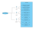
9. Localized Information:-
Provide information on local support services, government programs, and community events related to poverty alleviation.
User Profiles:-
Allow users to create profiles with information about their needs, such as essential items, financial assistance, or specific skills they are looking for.
7. Verification System:-
Implement a verification process for both those seeking assistance and those offering help to ensure the legitimacy of users and the safety of transactions.
8.Community Forum:-
Include a community forum where users can share success stories, offer advice, and discuss strategies for overcoming poverty.
6. Resource Listings:-
Create a section where donors can list available resources, such as food, clothing, or educational materials, making it easy for those in need to browse and request assistance.
4. Matching Algorithm:-
Implement a matching algorithm that connects individuals in need with suitable donors or volunteers based on location, preferences, and specific requirements.
Donor/Volunteer Registration:-
Enable donors and volunteers to register on the platform, providing details about their willingness to contribute, whether through financial donations, goods, or services.
3. Feedback and Ratings:-
Allow users to provide feedback and ratings based on their interactions, building a trustworthy and supportive community.
5. Real-time Messaging:-
Integrate a messaging system to facilitate communication between the parties involved, ensuring a transparent and secure channel for discussions and coordination.
Resource Requirement
User
Developer
Use
Resource Requirement of User
Resource Requirement of Developer
Case
Project Overview
Seva Sangh is a comprehensive web application designed to address and alleviate poverty by creating a direct and efficient connection between needy individuals and compassionate donors or volunteers. The platform aims to foster community support, empower users with knowledge, and track the positive impact of connections made through the app.
Key Features
Our Team and Mentorship
Basic Hardware:-
•Device: A computer, mobile phone, or tablet with sufficient processing power and memory.
•Operating System: A compatible operating system, such as Windows, macOS, Android, or iOS.
•Internet Connection: Access to a stable internet connection with adequate bandwidth.
Software:-
•Web Browser: An up-to-date web browser, such as Chrome, Firefox, Safari, or Edge.
Hosting:
Vercel
MongoDB Atlas
Learning Resources:
Official Next.js documentation
Tutorials and courses.
Community forums and resources: Engage with the Next.js community on GitHub Discussions, Discord, Twitter, and Reddit for support and knowledge sharing.
Additional Considerations:
React-top-loading-bar, React-Icons, react-loader-spinner
Domain Registration: GoDaddy
API Testing: Postman, Thunder Client
Analytics: Google Analytics and Next.js Analytics.
SEO: Google search console Tools, Bing Webmaster Tools, Meta Data, etc.
Mobile Responsiveness:-
Ensure that the web app is mobile-friendly, making it accessible to a broader range of users.
Accessibility:-
•Screen resolution: A minimum screen resolution is often not specified, but users with smaller screens might encounter layout issues.
•Visual acuity: Adequate vision to perceive elements on the screen.
•Input devices: Ability to use a mouse, keyboard, or touch screen to interact with the web app.
Additional Considerations:-
•JavaScript: Some web apps heavily rely on JavaScript, so JavaScript should be enabled in the browser.
•Cookies: cookies should be enabled in the browser.
In conclusion, there is no universal minimum requirement for all web apps.
Essential Requirements:
Node.js (version 18.17 or later recommended).
Code Editor: Visual Studio Code, Sublime Text.
Basic Dependencies:
React and ReactDOM
Next.js.
Team Members:-
Kulkamal Singh
Divye Gupta
Dolly Sharma
Nitish Jha
Mentor :-
Neelam Mam
Common Additional Dependencies:
Styling:
Tailwind CSS using postCSS
Adobe Photoshop 2021
Data Fetching:
Fetch API: Built-in for making API calls.
State Management:
React's built-in state.

Slide 20
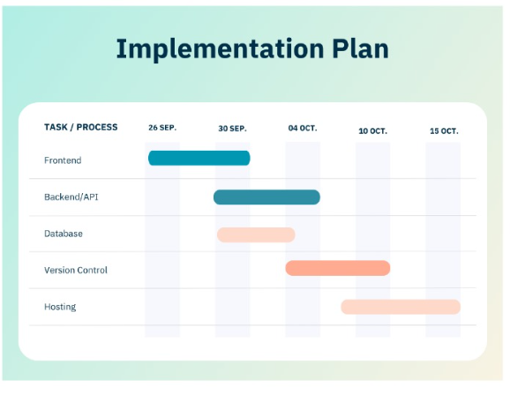
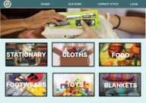
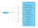
9. Localized Information:-
Provide information on local support services, government programs, and community events related to poverty alleviation.
User Profiles:-
Allow users to create profiles with information about their needs, such as essential items, financial assistance, or specific skills they are looking for.
7. Verification System:-
Implement a verification process for both those seeking assistance and those offering help to ensure the legitimacy of users and the safety of transactions.
8.Community Forum:-
Include a community forum where users can share success stories, offer advice, and discuss strategies for overcoming poverty.
6. Resource Listings:-
Create a section where donors can list available resources, such as food, clothing, or educational materials, making it easy for those in need to browse and request assistance.
4. Matching Algorithm:-
Implement a matching algorithm that connects individuals in need with suitable donors or volunteers based on location, preferences, and specific requirements.
Donor/Volunteer Registration:-
Enable donors and volunteers to register on the platform, providing details about their willingness to contribute, whether through financial donations, goods, or services.
3. Feedback and Ratings:-
Allow users to provide feedback and ratings based on their interactions, building a trustworthy and supportive community.
5. Real-time Messaging:-
Integrate a messaging system to facilitate communication between the parties involved, ensuring a transparent and secure channel for discussions and coordination.
Resource Requirement
User
Developer
Expected Outcome
Use
Case
Resource Requirement of User
Project Overview
Implementation Plan
Seva Sangh is a comprehensive web application designed to address and alleviate poverty by creating a direct and efficient connection between needy individuals and compassionate donors or volunteers. The platform aims to foster community support, empower users with knowledge, and track the positive impact of connections made through the app.
Key Features
Our Team and Mentorship
Basic Hardware:-
•Device: A computer, mobile phone, or tablet with sufficient processing power and memory.
•Operating System: A compatible operating system, such as Windows, macOS, Android, or iOS.
•Internet Connection: Access to a stable internet connection with adequate bandwidth.
Software:-
•Web Browser: An up-to-date web browser, such as Chrome, Firefox, Safari, or Edge.
Mobile Responsiveness:-
Ensure that the web app is mobile-friendly, making it accessible to a broader range of users.
Accessibility:-
•Screen resolution: A minimum screen resolution is often not specified, but users with smaller screens might encounter layout issues.
•Visual acuity: Adequate vision to perceive elements on the screen.
•Input devices: Ability to use a mouse, keyboard, or touch screen to interact with the web app.
Additional Considerations:-
•JavaScript: Some web apps heavily rely on JavaScript, so JavaScript should be enabled in the browser.
•Cookies: cookies should be enabled in the browser.
In conclusion, there is no universal minimum requirement for all web apps.
Essential Requirements:
Node.js: (version 18.17 or later recommended).
Code Editor: Visual Studio Code, Sublime Text.
Basic Dependencies:
React and ReactDOM
Next.js.
Team Members:-
Kulkamal Singh
Divye Gupta
Dolly Sharma
Nitish Jha
Mentor :-
Neelam Mam
Common Additional Dependencies:
Styling:
Tailwind CSS using postCSS
Bootstrap.
Adobe Photoshop 2021
Data Fetching:
Fetch API: Built-in for making API calls.
State Management:
React's built-in state.
Resource Requirement of Developer
Hosting:
Vercel
MongoDB Atlas
Learning Resources:
Official Next.js documentation
Tutorials and courses.
Community forums and resources: Engage with the Next.js community on GitHub Discussions, Discord, Twitter, and Reddit for support and knowledge sharing.
Additional Considerations:
React-top-loading-bar, React-Icons, react-loader-spinner
Domain Registration: GoDaddy
API Testing: Postman, Thunder Client
Analytics: Google Analytics and Next.js Analytics.
SEO: Google search console Tools, Bing Webmaster Tools, Meta Data, etc.

Slide 21

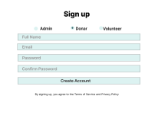
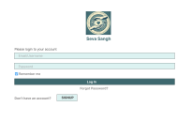
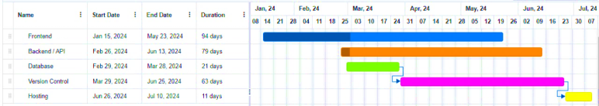
9. Localized Information:-
Provide information on local support services, government programs, and community events related to poverty alleviation.
User Profiles:-
Allow users to create profiles with information about their needs, such as essential items, financial assistance, or specific skills they are looking for.
7. Verification System:-
Implement a verification process for both those seeking assistance and those offering help to ensure the legitimacy of users and the safety of transactions.
8.Community Forum:-
Include a community forum where users can share success stories, offer advice, and discuss strategies for overcoming poverty.
6. Resource Listings:-
Create a section where donors can list available resources, such as food, clothing, or educational materials, making it easy for those in need to browse and request assistance.
4. Matching Algorithm:-
Implement a matching algorithm that connects individuals in need with suitable donors or volunteers based on location, preferences, and specific requirements.
Donor/Volunteer Registration:-
Enable donors and volunteers to register on the platform, providing details about their willingness to contribute, whether through financial donations, goods, or services.
3. Feedback and Ratings:-
Allow users to provide feedback and ratings based on their interactions, building a trustworthy and supportive community.
5. Real-time Messaging:-
Integrate a messaging system to facilitate communication between the parties involved, ensuring a transparent and secure channel for discussions and coordination.
Resource Requirement
User
Developer
Used
Case
Resource Requirement of User
Expected Outcome
Project Overview
Seva Sangh is a comprehensive web application designed to address and alleviate poverty by creating a direct and efficient connection between needy individuals and compassionate donors or volunteers. The platform aims to foster community support, empower users with knowledge, and track the positive impact of connections made through the app.
Key Features
Our Team and Mentorship
Basic Hardware:-
•Device: A computer, mobile phone, or tablet with sufficient processing power and memory.
•Operating System: A compatible operating system, such as Windows, macOS, Android, or iOS.
•Internet Connection: Access to a stable internet connection with adequate bandwidth.
Software:-
•Web Browser: An up-to-date web browser, such as Chrome, Firefox, Safari, or Edge.
Mobile Responsiveness:-
Ensure that the web app is mobile-friendly, making it accessible to a broader range of users.
Accessibility:-
•Screen resolution: A minimum screen resolution is often not specified, but users with smaller screens might encounter layout issues.
•Visual acuity: Adequate vision to perceive elements on the screen.
•Input devices: Ability to use a mouse, keyboard, or touch screen to interact with the web app.
Additional Considerations:-
•JavaScript: Some web apps heavily rely on JavaScript, so JavaScript should be enabled in the browser.
•Cookies: cookies should be enabled in the browser.
In conclusion, there is no universal minimum requirement for all web apps.
Essential Requirements:
Node.js: (version 18.17 or later recommended).
Code Editor: Visual Studio Code, Sublime Text.
Basic Dependencies:
React and ReactDOM
Next.js.
Team Members:-
Kulkamal Singh
Divye Gupta
Dolly Sharma
Nitish Jha
Mentor :-
Neelam Mam
Common Additional Dependencies:
Styling:
Tailwind CSS using postCSS
Bootstrap.
Adobe Photoshop 2021
Data Fetching:
Fetch API: Built-in for making API calls.
State Management:
React's built-in state.
Resource Requirement of Developer
Hosting:
Vercel
MongoDB Atlas
Learning Resources:
Official Next.js documentation
Tutorials and courses.
Community forums and resources: Engage with the Next.js community on GitHub Discussions, Discord, Twitter, and Reddit for support and knowledge sharing.
Additional Considerations:
React-top-loading-bar, React-Icons, react-loader-spinner
Domain Registration: GoDaddy
API Testing: Postman, Thunder Client
Analytics: Google Analytics and Next.js Analytics.
SEO: Google search console Tools, Bing Webmaster Tools, Meta Data, etc.
Implementation Plan

Slide 22
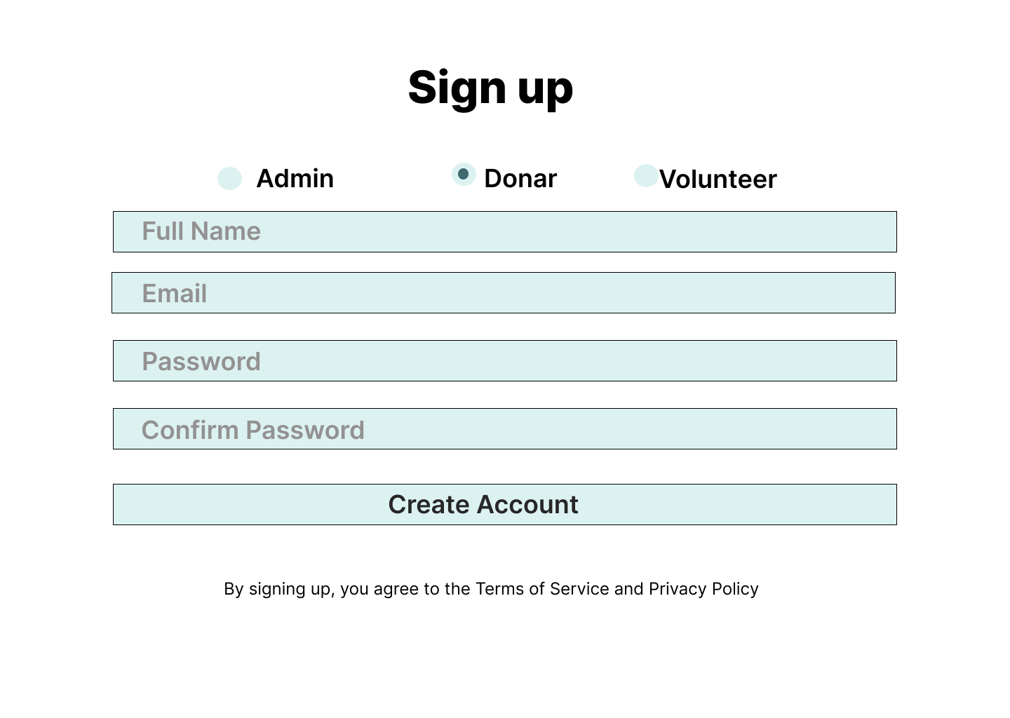
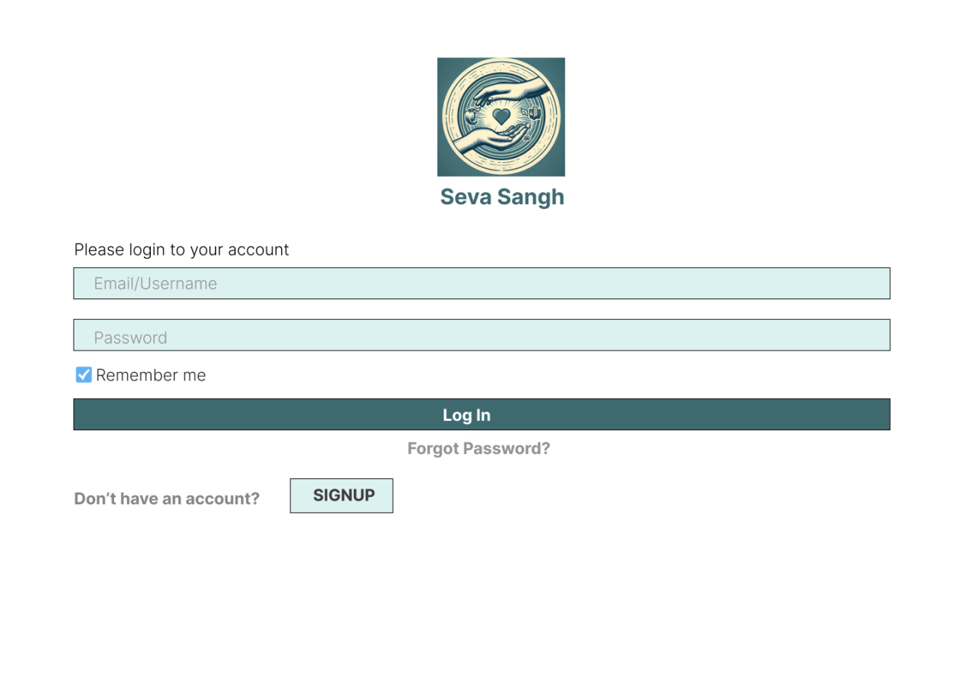
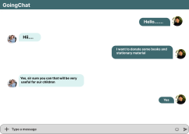

9. Localized Information:-
Provide information on local support services, government programs, and community events related to poverty alleviation.
User Profiles:-
Allow users to create profiles with information about their needs, such as essential items, financial assistance, or specific skills they are looking for.
7. Verification System:-
Implement a verification process for both those seeking assistance and those offering help to ensure the legitimacy of users and the safety of transactions.
8.Community Forum:-
Include a community forum where users can share success stories, offer advice, and discuss strategies for overcoming poverty.
6. Resource Listings:-
Create a section where donors can list available resources, such as food, clothing, or educational materials, making it easy for those in need to browse and request assistance.
4. Matching Algorithm:-
Implement a matching algorithm that connects individuals in need with suitable donors or volunteers based on location, preferences, and specific requirements.
Donor/Volunteer Registration:-
Enable donors and volunteers to register on the platform, providing details about their willingness to contribute, whether through financial donations, goods, or services.
3. Feedback and Ratings:-
Allow users to provide feedback and ratings based on their interactions, building a trustworthy and supportive community.
5. Real-time Messaging:-
Integrate a messaging system to facilitate communication between the parties involved, ensuring a transparent and secure channel for discussions and coordination.
Resource Requirement
User
Developer
Used
Case
Resource Requirement of User
Expected Outcome
Project Overview
Seva Sangh is a comprehensive web application designed to address and alleviate poverty by creating a direct and efficient connection between needy individuals and compassionate donors or volunteers. The platform aims to foster community support, empower users with knowledge, and track the positive impact of connections made through the app.
Key Features
Our Team and Mentorship
Basic Hardware:-
•Device: A computer, mobile phone, or tablet with sufficient processing power and memory.
•Operating System: A compatible operating system, such as Windows, macOS, Android, or iOS.
•Internet Connection: Access to a stable internet connection with adequate bandwidth.
Software:-
•Web Browser: An up-to-date web browser, such as Chrome, Firefox, Safari, or Edge.
Mobile Responsiveness:-
Ensure that the web app is mobile-friendly, making it accessible to a broader range of users.
Accessibility:-
•Screen resolution: A minimum screen resolution is often not specified, but users with smaller screens might encounter layout issues.
•Visual acuity: Adequate vision to perceive elements on the screen.
•Input devices: Ability to use a mouse, keyboard, or touch screen to interact with the web app.
Additional Considerations:-
•JavaScript: Some web apps heavily rely on JavaScript, so JavaScript should be enabled in the browser.
•Cookies: cookies should be enabled in the browser.
In conclusion, there is no universal minimum requirement for all web apps.
Essential Requirements:
Node.js: (version 18.17 or later recommended).
Code Editor: Visual Studio Code, Sublime Text.
Basic Dependencies:
React and ReactDOM
Next.js.
Team Members:-
Kulkamal Singh
Divye Gupta
Dolly Sharma
Nitish Jha
Mentor :-
Neelam Mam
Common Additional Dependencies:
Styling:
Tailwind CSS using postCSS
Bootstrap.
Adobe Photoshop 2021
Data Fetching:
Fetch API: Built-in for making API calls.
State Management:
React's built-in state.
Resource Requirement of Developer
Hosting:
Vercel
MongoDB Atlas
Learning Resources:
Official Next.js documentation
Tutorials and courses.
Community forums and resources: Engage with the Next.js community on GitHub Discussions, Discord, Twitter, and Reddit for support and knowledge sharing.
Additional Considerations:
React-top-loading-bar, React-Icons, react-loader-spinner
Domain Registration: GoDaddy
API Testing: Postman, Thunder Client
Analytics: Google Analytics and Next.js Analytics.
SEO: Google search console Tools, Bing Webmaster Tools, Meta Data, etc.
Implementation Plan

Slide 23

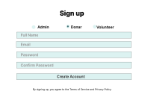

9. Localized Information:-
Provide information on local support services, government programs, and community events related to poverty alleviation.
User Profiles:-
Allow users to create profiles with information about their needs, such as essential items, financial assistance, or specific skills they are looking for.
7. Verification System:-
Implement a verification process for both those seeking assistance and those offering help to ensure the legitimacy of users and the safety of transactions.
8.Community Forum:-
Include a community forum where users can share success stories, offer advice, and discuss strategies for overcoming poverty.
6. Resource Listings:-
Create a section where donors can list available resources, such as food, clothing, or educational materials, making it easy for those in need to browse and request assistance.
4. Matching Algorithm:-
Implement a matching algorithm that connects individuals in need with suitable donors or volunteers based on location, preferences, and specific requirements.
Donor/Volunteer Registration:-
Enable donors and volunteers to register on the platform, providing details about their willingness to contribute, whether through financial donations, goods, or services.
3. Feedback and Ratings:-
Allow users to provide feedback and ratings based on their interactions, building a trustworthy and supportive community.
5. Real-time Messaging:-
Integrate a messaging system to facilitate communication between the parties involved, ensuring a transparent and secure channel for discussions and coordination.
Resource Requirement
User
Developer
Used
Case
Resource Requirement of User
Expected Outcome
Project Overview
Seva Sangh is a comprehensive web application designed to address and alleviate poverty by creating a direct and efficient connection between needy individuals and compassionate donors or volunteers. The platform aims to foster community support, empower users with knowledge, and track the positive impact of connections made through the app.
Key Features
Our Team and Mentorship
Basic Hardware:-
•Device: A computer, mobile phone, or tablet with sufficient processing power and memory.
•Operating System: A compatible operating system, such as Windows, macOS, Android, or iOS.
•Internet Connection: Access to a stable internet connection with adequate bandwidth.
Software:-
•Web Browser: An up-to-date web browser, such as Chrome, Firefox, Safari, or Edge.
Mobile Responsiveness:-
Ensure that the web app is mobile-friendly, making it accessible to a broader range of users.
Accessibility:-
•Screen resolution: A minimum screen resolution is often not specified, but users with smaller screens might encounter layout issues.
•Visual acuity: Adequate vision to perceive elements on the screen.
•Input devices: Ability to use a mouse, keyboard, or touch screen to interact with the web app.
Additional Considerations:-
•JavaScript: Some web apps heavily rely on JavaScript, so JavaScript should be enabled in the browser.
•Cookies: cookies should be enabled in the browser.
In conclusion, there is no universal minimum requirement for all web apps.
Essential Requirements:
Node.js: (version 18.17 or later recommended).
Code Editor: Visual Studio Code, Sublime Text.
Basic Dependencies:
React and ReactDOM
Next.js.
Team Members:-
Kulkamal Singh
Divye Gupta
Dolly Sharma
Nitish Jha
Mentor :-
Neelam Mam
Common Additional Dependencies:
Styling:
Tailwind CSS using postCSS
Bootstrap.
Adobe Photoshop 2021
Data Fetching:
Fetch API: Built-in for making API calls.
State Management:
React's built-in state.
Resource Requirement of Developer
Hosting:
Vercel
MongoDB Atlas
Learning Resources:
Official Next.js documentation
Tutorials and courses.
Community forums and resources: Engage with the Next.js community on GitHub Discussions, Discord, Twitter, and Reddit for support and knowledge sharing.
Additional Considerations:
React-top-loading-bar, React-Icons, react-loader-spinner
Domain Registration: GoDaddy
API Testing: Postman, Thunder Client
Analytics: Google Analytics and Next.js Analytics.
SEO: Google search console Tools, Bing Webmaster Tools, Meta Data, etc.
Implementation Plan

Slide 24

9. Localized Information:-
Provide information on local support services, government programs, and community events related to poverty alleviation.
User Profiles:-
Allow users to create profiles with information about their needs, such as essential items, financial assistance, or specific skills they are looking for.
7. Verification System:-
Implement a verification process for both those seeking assistance and those offering help to ensure the legitimacy of users and the safety of transactions.
8.Community Forum:-
Include a community forum where users can share success stories, offer advice, and discuss strategies for overcoming poverty.
6. Resource Listings:-
Create a section where donors can list available resources, such as food, clothing, or educational materials, making it easy for those in need to browse and request assistance.
4. Matching Algorithm:-
Implement a matching algorithm that connects individuals in need with suitable donors or volunteers based on location, preferences, and specific requirements.
Donor/Volunteer Registration:-
Enable donors and volunteers to register on the platform, providing details about their willingness to contribute, whether through financial donations, goods, or services.
3. Feedback and Ratings:-
Allow users to provide feedback and ratings based on their interactions, building a trustworthy and supportive community.
5. Real-time Messaging:-
Integrate a messaging system to facilitate communication between the parties involved, ensuring a transparent and secure channel for discussions and coordination.
Resource Requirement
User
Developer
Expected Outcome
Used
Case
Resource Requirement of User
Project Overview
Seva Sangh is a comprehensive web application designed to address and alleviate poverty by creating a direct and efficient connection between needy individuals and compassionate donors or volunteers. The platform aims to foster community support, empower users with knowledge, and track the positive impact of connections made through the app.
Key Features
Our Team and Mentorship
Basic Hardware:-
•Device: A computer, mobile phone, or tablet with sufficient processing power and memory.
•Operating System: A compatible operating system, such as Windows, macOS, Android, or iOS.
•Internet Connection: Access to a stable internet connection with adequate bandwidth.
Software:-
•Web Browser: An up-to-date web browser, such as Chrome, Firefox, Safari, or Edge.
THANK YOU
Mobile Responsiveness:-
Ensure that the web app is mobile-friendly, making it accessible to a broader range of users.
Accessibility:-
•Screen resolution: A minimum screen resolution is often not specified, but users with smaller screens might encounter layout issues.
•Visual acuity: Adequate vision to perceive elements on the screen.
•Input devices: Ability to use a mouse, keyboard, or touch screen to interact with the web app.
Additional Considerations:-
•JavaScript: Some web apps heavily rely on JavaScript, so JavaScript should be enabled in the browser.
•Cookies: cookies should be enabled in the browser.
In conclusion, there is no universal minimum requirement for all web apps.
Essential Requirements:
Node.js: (version 18.17 or later recommended).
Code Editor: Visual Studio Code, Sublime Text.
Basic Dependencies:
React and ReactDOM
Next.js.
Team Members:-
Kulkamal Singh
Divye Gupta
Dolly Sharma
Nitish Jha
Mentor :-
Neelam Mam
Common Additional Dependencies:
Styling:
Tailwind CSS using postCSS
Bootstrap.
Adobe Photoshop 2021
Data Fetching:
Fetch API: Built-in for making API calls.
State Management:
React's built-in state.
Resource Requirement of Developer
Hosting:
Vercel
MongoDB Atlas
Learning Resources:
Official Next.js documentation
Tutorials and courses.
Community forums and resources: Engage with the Next.js community on GitHub Discussions, Discord, Twitter, and Reddit for support and knowledge sharing.
Additional Considerations:
React-top-loading-bar, React-Icons, react-loader-spinner
Domain Registration: GoDaddy
API Testing: Postman, Thunder Client
Analytics: Google Analytics and Next.js Analytics.
SEO: Google search console Tools, Bing Webmaster Tools, Meta Data, etc.
Implementation Plan

